Slide 1






Speaking in Melbo’s mother tongue
1000001011010010100001000001101110110111101111010000101010100110110101101101000010111110000110110101
Model
Features
Vectors
An ordered list of numbers
$$≠$$
1.0
-1.5
2.0
-2.5
0.0
2.0
1.0
0.0
-1.5
-2.5
Since we have become such good friends, let me teach you a bit more about my mother tongue

Slide 2
geometry crash course
can time series models predict how long we need to wait till the next video gets uploaded ?? … just asking for a friend …

Slide 3








Vectors
Does not matter in which order we move along the coordinate axes
$$z$$
$$y$$
5
4
3
2
1
0
$$x$$
$$x$$
$$y$$
-4 -3 -2 -1 0 1 2 3 4
$$u=$$
3.5
4.0
$$v=$$
-1.5
2.5
$$w=$$
3.5
2.5
4.0

Slide 4
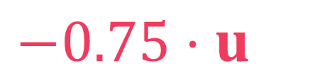






How to stretch, shrink and flip vectors
$$y$$
Scalar multiplication
4
$$u=$$
1.5
2.0
3
$$2⋅u=$$
3.0
4.0
2
$$−1.5⋅u=$$
-2.25
-3.0
1
$$x$$
-4 -3 -2 -1 0 1 2 3 4
$$0.5⋅u=$$
0.75
1.0
-1
$$−0.75⋅u=$$
-1.125
-1.5
-2
The sign of the scalar decides if the vector will get flipped or not. A magnitude of less than one will shrink the vector and more than one will stretch the vector
-3
-4

Slide 5





How to add vectors
The coordinate-wise rule remains the same even if adding/subtracting more than 2 vectors in more than 2 dimensions
$$y$$
Vector addition/subtraction
Add/subtract coordinate-wise
Complete the Parallelogram
4
3
2
$$u=$$
1.5
2.0
1
$$v=$$
2.0
-2.5
$$x$$
-4 -3 -2 -1 0 1 2 3 4
$$u+v=$$
3.5
-0.5
-1
$$u−v=$$
-0.5
4.5
-2
$$−0.5⋅u+0.5⋅v=$$
-3
0.25
-2.25
-4

Slide 6



How to measure the length of a vector
$$y$$
Euclidean length
$\sqrt{{\left(−3.0\right)}^{2}+{\left(4.0\right)}^{2}}=5.0$
$\sqrt{{\left(6.0\right)}^{2}+{\left(−2.0\right)}^{2}+{\left(−3.0\right)}^{2}}=7.0$
4
$$u=$$
-3.0
4.0
3
2
1
$$x$$
$$w=$$
6.0
-2.0
-3.0
-4 -3 -2 -1 0 1 2 3 4
-1
-2
-3
-4

Slide 7

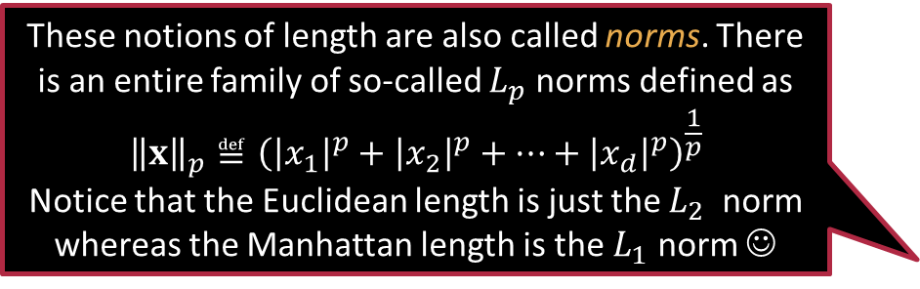

How to measure the length of a vector
$$y$$
Taxicab/Manhattan length
$\left|−3.0\right|+\left|4.0\right|=7.0$
$\left|6.0\right|+\left|−2.0\right|+\left|−3.0\right|=11.0$
4
$$u=$$
-3.0
4.0
3
2
1
$$x$$
$$w=$$
6.0
-2.0
-3.0
-4 -3 -2 -1 0 1 2 3 4
-1
These notions of length are also called norms. There is an entire family of so-called $L_{p}$ norms defined as $${\left\|x\right\|}_{p}≝{\left({\left|x_{1}\right|}^{p}+{\left|x_{2}\right|}^{p}+…+{\left|x_{d}\right|}^{p}\right)}^{\frac{1}{p}}$$
Notice that the Euclidean length is just the $L_{2}$ norm whereas the Manhattan length is the $L_{1}$ norm ☺
-2
-3
-4

Slide 8
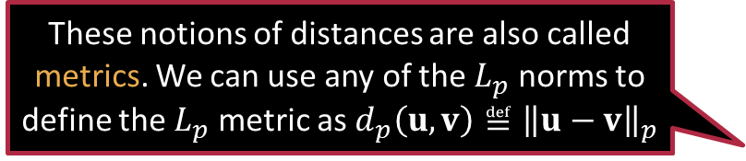

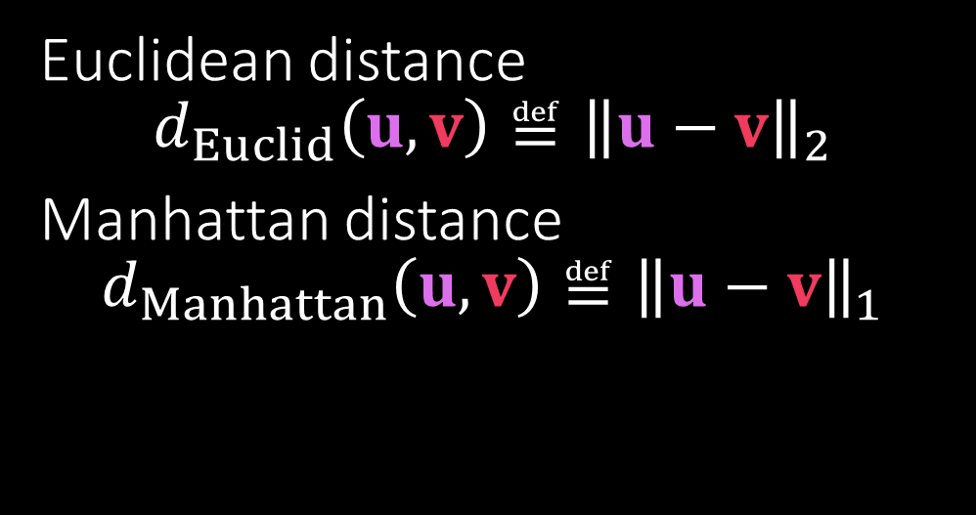


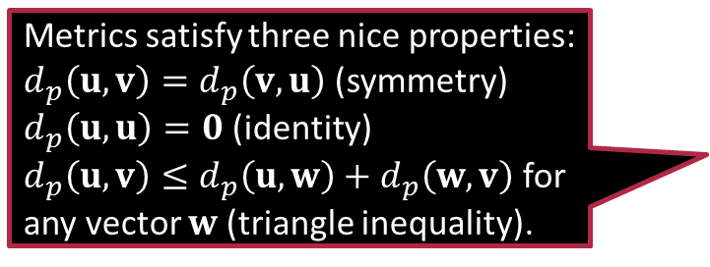
How to measure distances
Metrics satisfy three nice properties:
$d_{p}\left(u,v\right)=d_{p}\left(v,u\right)$ (symmetry)
$d_{p}\left(u,u\right)=0$ (identity)
$d_{p}\left(u,v\right)≤d_{p}\left(u,w\right)+d_{p}\left(w,v\right)$ for any vector $w$ (triangle inequality).
$$y$$
$$u=$$
1.5
2.0
4
3
$$v=$$
2.0
-2.5
2
$$u−v=$$
-0.5
4.5
1
Euclidean distance $d_{Euclid}\left(u,v\right)≝{\left\|u−v\right\|}_{2}$
Manhattan distance $d_{Manhattan}\left(u,v\right)≝{\left\|u−v\right\|}_{1}$
$$x$$
-4 -3 -2 -1 0 1 2 3 4
-1
-2
These notions of distances are also called metrics. We can use any of the $L_{p}$ norms to define the $L_{p}$ metric as $d_{p}\left(u,v\right)≝{\left\|u−v\right\|}_{p}$
-3
-4

Slide 9



How to measure angles
Two vectors are at an obtuse angle if their dot product is $<0$. Two vectors are at an acute angle if their dot product is $>0$
$$y$$
$$u=$$
1.0
2.0
The definition of the dot product and this way to use it to calculate angles can be used in higher dimensions as well
4
3
$$v=$$
2.0
-2.0
2
Dot product $\left\langle u,v\right\rangle ≝u^{⊤}v=\sum_{i=1}^{d}{u_{i}⋅v_{i}}$ $=1.0⋅2.0+2.0⋅\left(−2.0\right)=−2$
$\left\langle u,v\right\rangle ={\left\|u\right\|}_{2}⋅{\left\|v\right\|}_{2}⋅\cos\left(θ\right)$
$θ=\cos^{−1}\left(\frac{\left\langle u,v\right\rangle }{{\left\|u\right\|}_{2}⋅{\left\|v\right\|}_{2}}\right)$
1
$$x$$
-4 -3 -2 -1 0 1 2 3 4
$$θ$$
-1
-2
-3
-4

Slide 10



How to measure angles
Let us give you a simple proof of why dot products can be used to calculate angles
Two vectors are perpendicular if their dot product is $0$
$$y$$
$$u=$$
-2.0
-1.0
4
3
$$v=$$
-2.0
4.0
2
Dot product $\left\langle u,v\right\rangle ≝u^{⊤}v=\sum_{i=1}^{d}{u_{i}⋅v_{i}}$ $=\left(−2\right)⋅\left(−2\right)+\left(−1\right)⋅4=0$
$\left\langle u,v\right\rangle ={\left\|u\right\|}_{2}⋅{\left\|v\right\|}_{2}⋅\cos\left(θ\right)$
$θ=\cos^{−1}\left(\frac{\left\langle u,v\right\rangle }{{\left\|u\right\|}_{2}⋅{\left\|v\right\|}_{2}}\right)$
$$θ=\frac{π}{2}$$
1
$$x$$
-4 -3 -2 -1 0 1 2 3 4
-1
-2
-3
-4

Slide 11















Dot product helps us measure angles
$$y$$
$$u=$$
$$u=$$
$$v=$$
$$x$$
$$v=$$
$$a$$
$$y$$
$$b$$
$$p$$
$$\sqrt{p^{2}+q^{2}}$$
$$q$$
4
$$0$$
$$b$$
3
Let’s rotate the vectors
Doesn’t change the angle or dot product (proof of latter later)
Claim: $\left\langle u,v\right\rangle ={\left\|u\right\|}_{2}⋅{\left\|v\right\|}_{2}⋅\cos\left(θ\right)$
Proof: $\left\langle u,v\right\rangle =a⋅\sqrt{p^{2}+q^{2}}+b⋅0$
${\left\|u\right\|}_{2}=\sqrt{a^{2}+b^{2}},{\left\|v\right\|}_{2}=\sqrt{p^{2}+q^{2}}$
$\cos\left(θ\right)=a/\sqrt{a^{2}+b^{2}}$ (cos = base/hyp)
Clearly, we do have $\left\langle u,v\right\rangle ={\left\|u\right\|}_{2}⋅{\left\|v\right\|}_{2}⋅\cos\left(θ\right) □$
2
1
$$x$$
-4 -3 -2 -1
0 1 2 3 4
$$θ$$
$$a$$
-1
-2
-3
-4

Slide 12






An application of norms in ML
$$ℬ_{2}\left(c,r\right)≝\left\{u:{\left\|u−c\right\|}_{2}≤r\right\}$$
Anomaly or attack detection
$$c$$
$$r$$
$$d$$
$$s$$
There are algorithms to find the smallest enclosing ball for a given set of data points
$$ℬ_{1}\left(d,s\right)≝\left\{v:{\left\|v−d\right\|}_{1}≤s\right\}$$

Slide 13







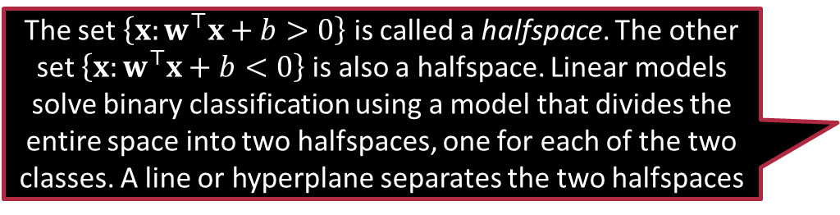
An application of dot products in ML
$$y$$
Binary classification is often solved using a linear model (in 2D, just a line) $y=mx+b$
Can rewrite this as $w^{⊤}x+b=0$
where $w=\left(m,−1\right),x=\left(x,y\right)∈ℝ^{2}$
Changing $w$ changes the slope of the line but keeps the intercept unchanged
$$x$$
Changing $b$ does not change the slope of the line. It just changes the intercept
$$b$$
$$w^{⊤}x+b>0⇒ \\ w^{⊤}x+b<0⇒$$
The set $\left\{x:w^{⊤}x+b>0\right\}$ is called a halfspace. The other set $\left\{x:w^{⊤}x+b<0\right\}$ is also a halfspace. Linear models solve binary classification using a model that divides the entire space into two halfspaces, one for each of the two classes. A line or hyperplane separates the two halfspaces

Slide 14



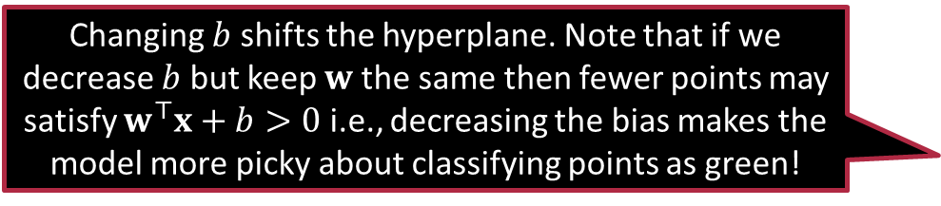
Linear models in higher dimensions
Changing $b$ shifts the hyperplane. Note that if we decrease $b$ but keep $w$ the same then fewer points may satisfy $w^{⊤}x+b>0$ i.e., decreasing the bias makes the model more picky about classifying points as green!
The same trick works in higher dimensions by learning a hyperplane classifier $w^{⊤}x+b=0$ where $w,x∈ℝ^{d}, b∈ℝ$
The hyperplane itself $\left\{x:w^{⊤}x+b=0\right\}$ is often called the “decision boundary”
The vector $w$ is the normal or perpendicular vector of the hyperplane
Consider any two vectors $x,y$ on the hyperplane i.e.,$w^{⊤}x+b=0=w^{⊤}y+b$
Note that this means $w^{⊤}(x−y)=0$
The vector $x−y$ is parallel to the hyperplane and $w$ perpendicular to all such vectors
$$w$$
Changing $w$ rotates the hyperplane

Slide 15


To $b$ or not to $b$ – that is the question
Sometimes, ML algos are simpler if we do not have a bias term
However, having a bias term is often critical so we cheat a bit and hide it
Create another dim in feature vector and fill it with 1 i.e., $\tilde{x}=\left[x,1\right]$
Note that features are now $\left(d+1\right)$-dimensional, so must be the model
Learn a $\left(d+1\right)$-dimensional linear model but without bias term
Let the new model be $\tilde{w}=\left[w_{1},w_{2},…,w_{d+1}\right]∈ℝ^{d+1}$
If we denote $w=\left[w_{1},…w_{d}\right]∈ℝ^{d}$, then
${\tilde{w}}^{⊤}\tilde{x}=w^{⊤}x+w_{d+1}$
Thus, $w_{d+1}$ effectively acts as a bias term for us ☺

Slide 16

Exercise
Given a hyperplane $w^{⊤}x+b=0$ where $w,x∈ℝ^{d}, b∈ℝ$, show that the $L_{2}$ distance of the origin i.e., $0$ vector from the hyperplane is ${\left|b\right|}/{{\left\|w\right\|}_{2}}$.
The distance of a point $v$ from a hyperplane is defined as the shortest distance of that point from any point on the hyperplane i.e., $min\left\{{\left\|v−p\right\|}_{2}:w^{⊤}p+b=0\right\}$
Prove the famous Cauchy-Schwartz inequality that states that for any two vectors $u,v∈ℝ^{d}$, we have $\left|u^{⊤}v\right|≤{\left\|u\right\|}_{2}⋅{\left\|v\right\|}_{2}$
Hint: try using the claim we just proved

Slide 17













Convex Sets
$$x$$
$$x$$
$$x$$
$$y$$
$$𝒞⊆ℝ^{d}$$
$$z$$
$$z$$
$$y$$
$$∀x,y∈𝒞$$
$$y$$
CONVEX SET
NON-CONVEX SET
$$∀λ∈\left[0,1\right]$$
$$z=λ ⋅x+\left(1−λ\right)⋅y$$
$$∈𝒞$$
Think about which common shapes and objects are convex and which are not – balls, cuboids, stars, rectangles?

Slide 18

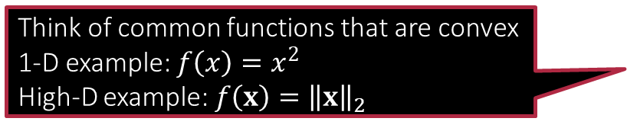







Convex Functions
If you “fill up” the space above the function curve and that set looks convex, then the function is convex too
$$f:ℝ^{d}→ℝ$$
$$x$$
$$z$$
$$y$$
$$x$$
$$z$$
$$y$$
$$∀x,y∈𝒞$$
CONVEX FUNCTION
NON-CONVEX
FUNCTION
$$∀λ∈\left[0,1\right]$$
Think of common functions that are convex
1-D example: $f\left(x\right)=x^{2}$
High-D example: $f\left(x\right)={\left\|x\right\|}_{2}$
$$z=λ ⋅x+\left(1−λ\right)⋅y$$
$$f\left(z\right)≤λ ⋅f\left(x\right)+\left(1−λ\right)⋅f\left(y\right)$$
A convex function must lie below all its chords

Slide 19

Some handy tips for checking convexity
All constant functions $f\left(x\right)=c$ are convex
All linear functions $f\left(x\right)=a^{⊤}x$ are convex
Sums of convex functions are convex
$g\left(x\right)=a^{⊤}x+b$ is convex
Positive multiples of convex functions $c⋅f\left(x\right), c≥0$ are convex
If $g:ℝ^{d}→ℝ$ is convex and $f:ℝ→ℝ$ is convex and non-decreasing i.e., $a≥b⇒f\left(a\right)≥f\left(b\right)$, then the function $f∘g:ℝ^{d}→ℝ$ defined as $\left(f∘g\right)\left(x\right)≝f\left(g\left(x\right)\right)$ is convex
If $f:ℝ→ℝ$ is convex then $h\left(x\right)=f\left(a^{⊤}x+b\right)$ is also convex
The $L_{2}$ norm function i.e., $f\left(x\right)={\left\|x\right\|}_{2}$ is convex

Slide 20

Exercise
Show that the intersection of two convex sets is always convex
Find an example of two convex sets whose union is not convex
Show that every halfspace $\left\{x:w^{⊤}x+b>0\right\}$ is a convex set
Show that the ball $ℬ_{2}\left(0,1\right)≝\left\{v:{\left\|v\right\|}_{2}≤1\right\}$ is a convex set
Show that the sum of two convex functions is always convex
Find an example of two convex functions whose difference is not a convex function

Slide 21
Summary
Vectors offer an expressive language to express features and outputs
Can be seen as an arrow with a length and a direction
Can also be seen as an ordered list of numbers
Can be scaled and added/subtracted together
Norms (Euclidean, Manhattan etc) allow us to calculate lengths of vectors
Metrics allow us to calculate distances between two points in space
The dot product allows us to calculate the angle between two vectors
Norms and dot products are used in ML to create classifier models
The linear model does binary classfn by dividing the space into two halfspaces
The bias term in a linear model is often hidden inside the normal vector itself
Convex sets contain their chords, convex funcs. lie below their chords

Slide 22
Stay Marvelous!
Chat with you next time

